Slide 1
Band Theory of Solids

Slide 2
Learning objectives
The primary learning objective is to describe the electrical properties of solid using band theory.
Explain the presence of energy bands and gaps in the energy structure of a crystal
Explain why some materials are good conductors and others are good insulators
Differentiate between an insulator and a semiconductor

Slide 3
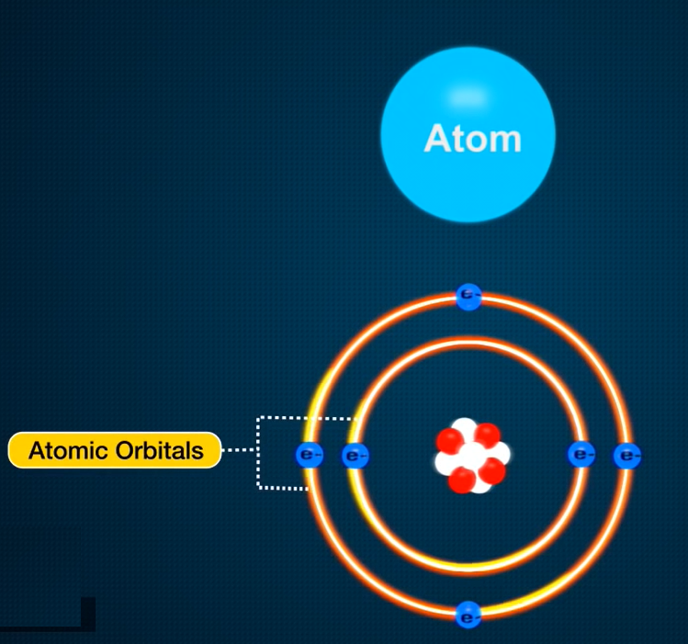
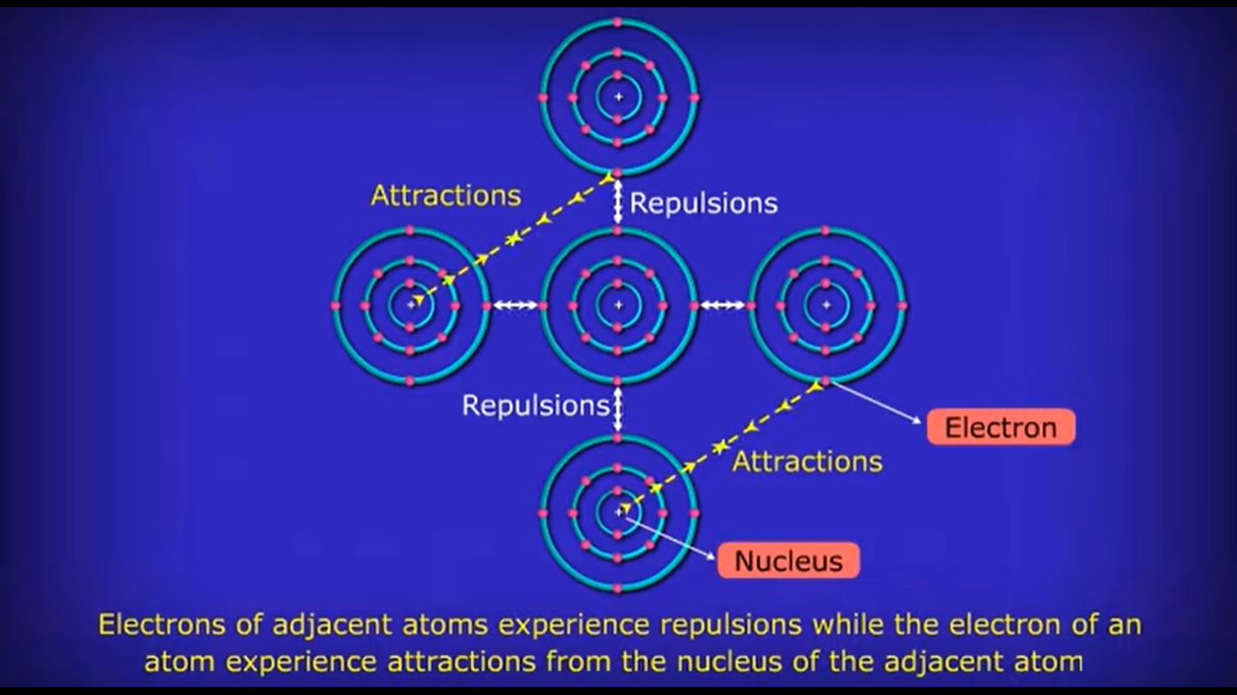
Band Theory
Bonding in metals and semiconductors can be described using band theory, in which a set of molecular orbitals is generated that extends throughout the solid.
One-Dimensional Systems
If the distance between the metal atoms is short enough for the orbitals to interact, they produce bonding, antibonding, and nonbonding molecular orbitals.

Slide 4
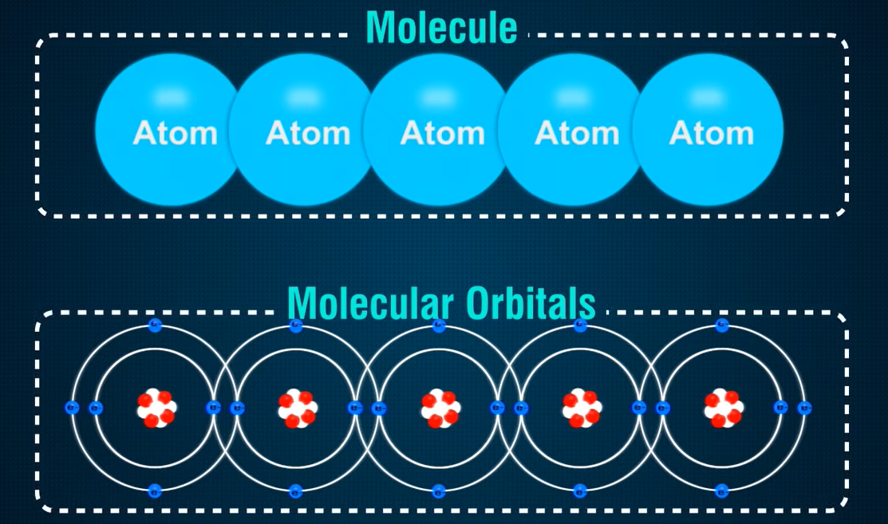
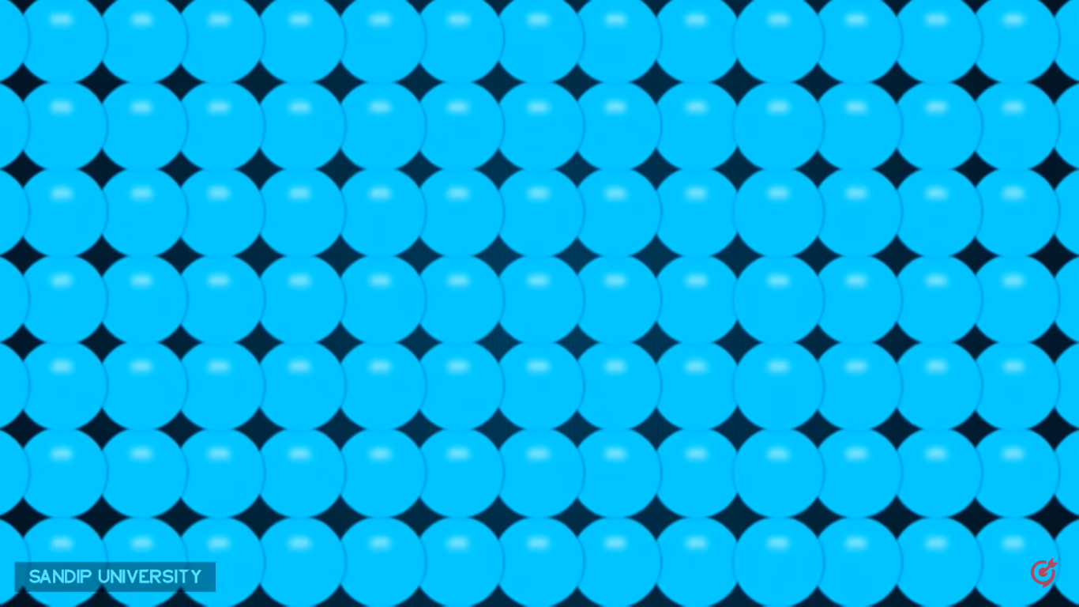


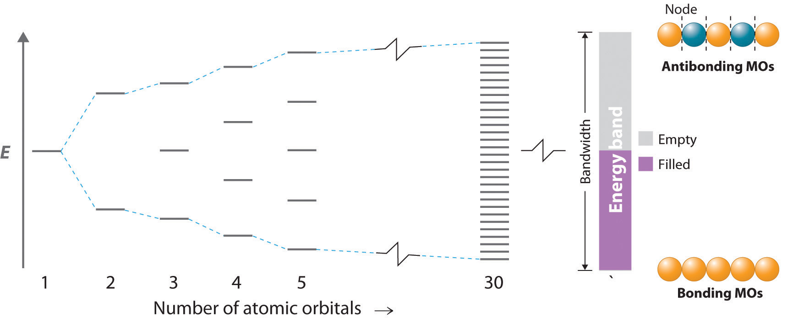
The Molecular Orbital Energy-Level Diagram for a Linear Arrangement of n Atoms, Each of Which Contains a Singly Occupied s Orbital.

Slide 5
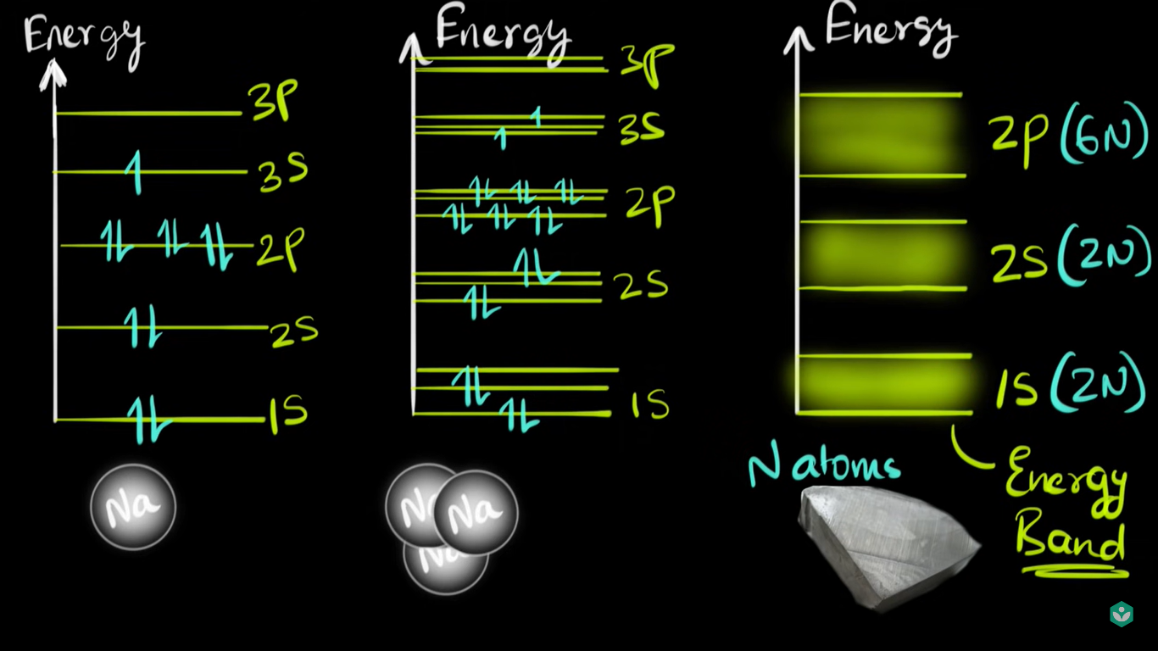
Two- or three-dimensional systems and atoms with electrons in p and d orbitals is straightforward in principle, the resulting energy-level diagrams are essentially the same as the diagram of the one-dimensional example in the previous slide, with the following exception: they contain as many bands as there are different types of interacting orbitals. Because different atomic orbitals interact differently, each band will have a different bandwidth and will be centered at a different energy, corresponding to the energy of the parent atomic orbital of an isolated atom.

Slide 6
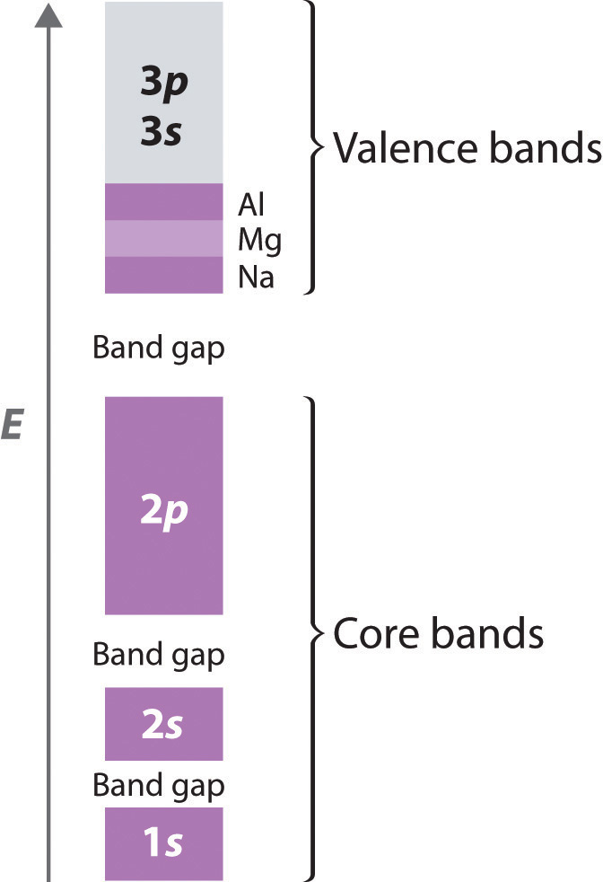
Band Gap
Because they extend farther from the nucleus, the valence orbitals of adjacent atoms (3s and 3p in Figure) interact much more strongly with one another than do the filled core levels; as a result, the valence bands have a larger bandwidth. In fact, the bands derived from the 3s and 3p atomic orbitals are wider than the energy gap between them, so the result is overlapping bands.
The combined band that arises from the overlap of the 3s and 3p bands is also filling up; it has a total capacity of eight electrons per atom (two electrons for each 3s orbital and six electrons for each set of 3p orbitals). With Na, therefore, which has one valence electron, the combined valence band is one-eighth filled; with Mg (two valence electrons), it is one-fourth filled; and with Al, it is three-eighths filled, as indicated in Figure
The Band Structures of the Period 3 Metals Na, Mg, and Al. The 3s and 3p valence bands overlap in energy to form a continuous set of energy levels that can hold a maximum of eight electrons per atom

Slide 7
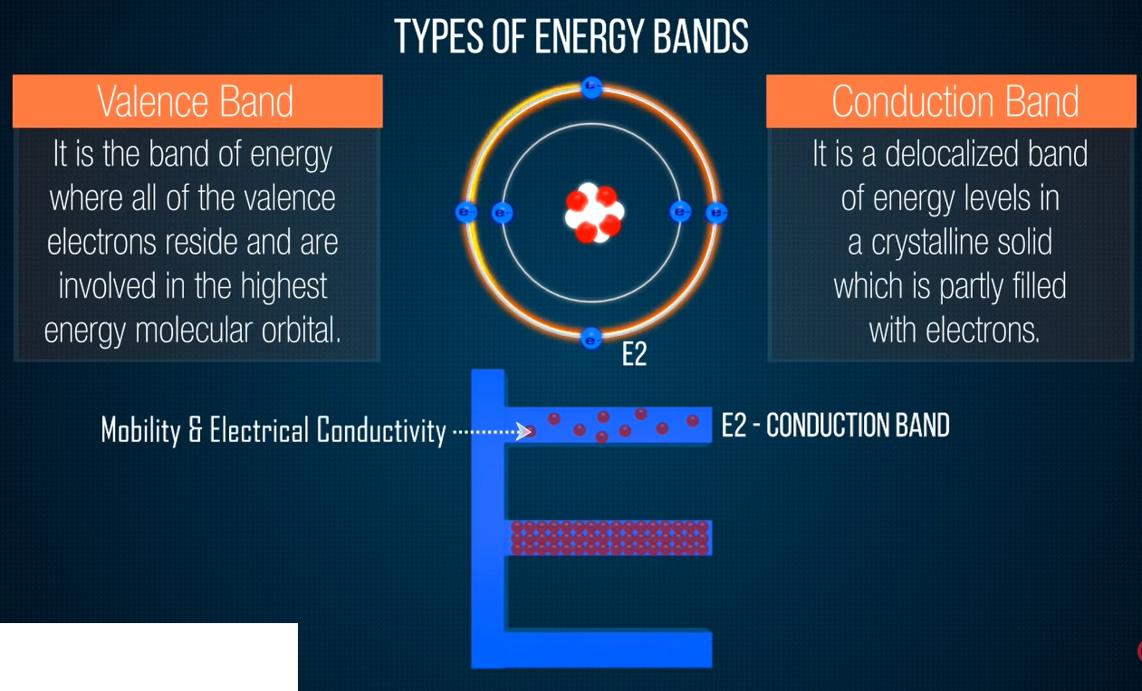


Slide 8


Slide 9


Slide 10
Band theory can explain properties of metals
Metals conduct electricity, for example, because only a very small amount of energy is required to excite an electron from a filled level to an empty one, where it is free to migrate rapidly throughout the crystal in response to an applied electric field.
Metals have high heat capacities because the electrons in the valence band can absorb thermal energy by being excited to the low-lying empty energy levels.
Metals are lustrous because light of various wavelengths can be absorbed, causing the valence electrons to be excited into any of the empty energy levels above the highest occupied level. When the electrons decay back to low-lying empty levels, they emit light of different wavelengths. Because electrons can be excited from many different filled levels in a metallic solid and can then decay back to any of many empty levels, light of varying wavelengths is absorbed and reemitted, which results in the characteristic shiny appearance that we associate with metals.

Slide 11
For a solid to exhibit metallic behavior
it must have a set of delocalized orbitals forming a band of allowed energy levels, and
the resulting band must be partially filled (10%–90%) with electrons.
Band theory explains the correlation between the valence electron configuration of a metal and the strength of metallic bonding. The valence electrons of transition metals occupy either their valence ns, (n − 1)d, and np orbitals (with a total capacity of 18 electrons per metal atom) or their ns and (n − 1)d orbitals (a total capacity of 12 electrons per metal atom). These atomic orbitals are close enough in energy that the derived bands overlap, so the valence electrons are not confined to a specific orbital. Metals with 6 to 9 valence electrons (which correspond to groups 6–9) are those most likely to fill the valence bands approximately halfway. Those electrons therefore occupy the highest possible number of bonding levels, while the number of antibonding levels occupied is minimal. Not coincidentally, the elements of these groups exhibit physical properties consistent with the presence of the strongest metallic bonding, such as very high melting points.

Slide 12
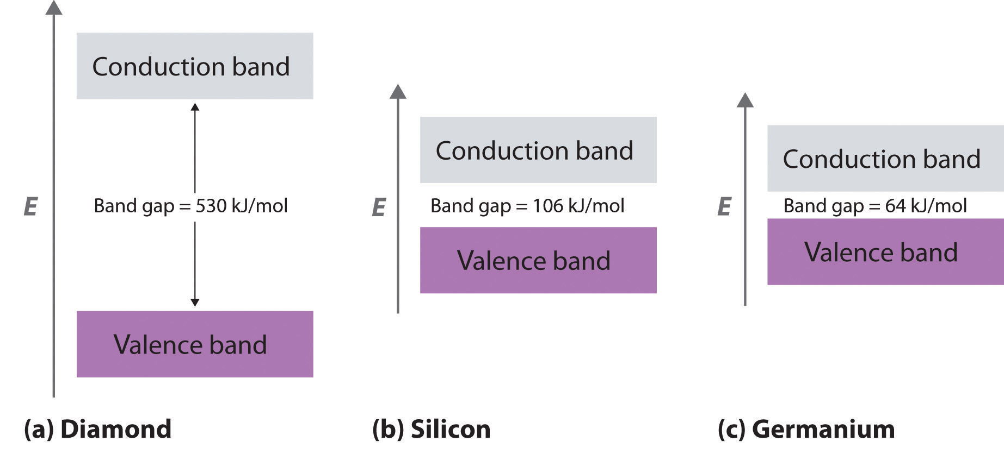
Insulators
In contrast to metals, electrical insulators are materials that conduct electricity poorly because their valence bands are full. The energy gap between the highest filled levels and the lowest empty levels is so large that the empty levels are inaccessible: thermal energy cannot excite an electron from a filled level to an empty one.
The valence-band structure of diamond: Because diamond has only 4 bonded neighbors rather than the 6 to 12 typical of metals, the carbon 2s and 2p orbitals combine to form two bands in the solid, with the one at lower energy representing bonding molecular orbitals and the one at higher energy representing antibonding molecular orbitals. Each band can accommodate four electrons per atom, so only the lower band is occupied.
the energy gap between the filled band and the empty band is very large (530 kJ/mol), at normal temperatures thermal energy cannot excite electrons from the filled level into the empty band.

Slide 13
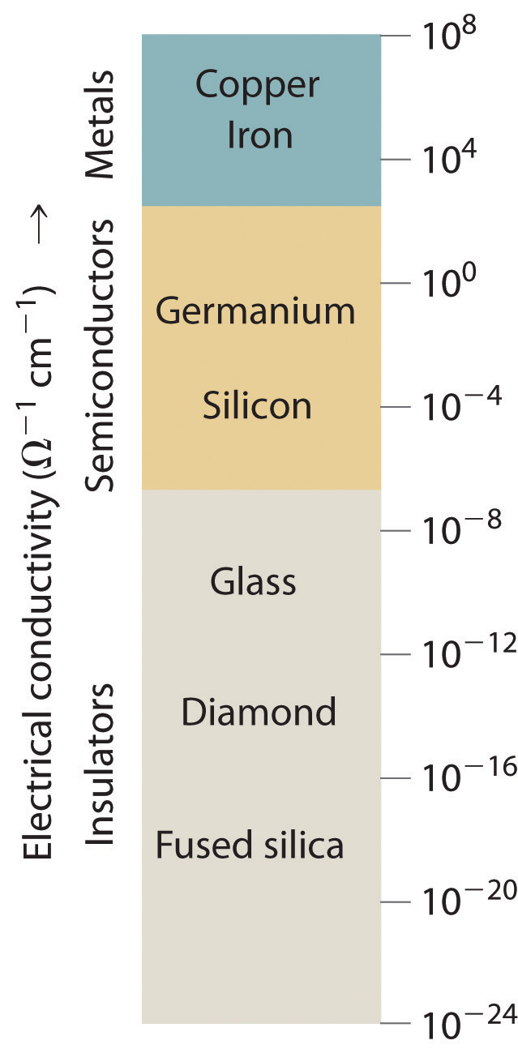
Semiconductors
What if the difference in energy between the highest occupied level and the lowest empty level is intermediate between those of electrical conductors and insulators?
Because Si–Si and Ge–Ge bonds are substantially weaker than C–C bonds, the energy gap between the filled and empty bands becomes much smaller as we go down group 14
Consequently, thermal energy is able to excite a small number of electrons from the filled valence band of Si and Ge into the empty band above it, which is called the conduction band.
A Logarithmic Scale Illustrating the Enormous Range of Electrical Conductivities of Solids

Slide 14
Exciting electrons from the filled valence band to the empty conduction band causes an increase in electrical conductivity for two reasons:
The electrons in the previously vacant conduction band are free to migrate through the crystal in response to an applied electric field.
Excitation of an electron from the valence band produces a “hole” in the valence band that is equivalent to a positive charge. The hole in the valence band can migrate through the crystal in the direction opposite that of the electron in the conduction band by means of a “bucket brigade” mechanism in which an adjacent electron fills the hole, thus generating a hole where the second electron had been, and so forth.
Consequently, Si is a much better electrical conductor than diamond, and Ge is even better, although both are still much poorer conductors than a typical meta

Slide 15
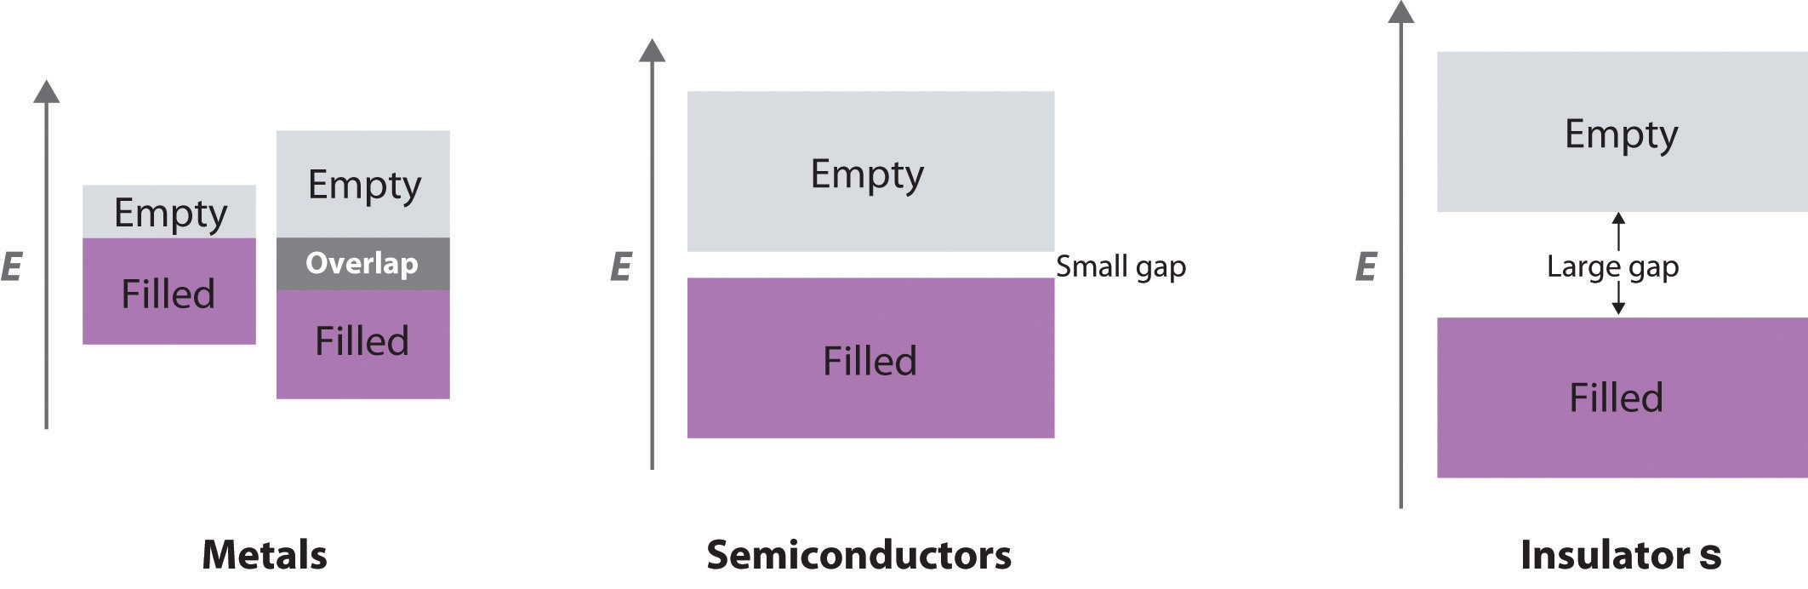
Substances such as Si and Ge that have conductivities between those of metals and insulators are called semiconductors. Many binary compounds of the main group elements exhibit semiconducting behavior similar to that of Si and Ge. For example, gallium arsenide (GaAs) is isoelectronic with Ge and has the same crystalline structure, with alternating Ga and As atoms; not surprisingly, it is also a semiconductor. The electronic structure of semiconductors is compared with the structures of metals and insulators

Slide 16
Temperature and Conductivity
Because thermal energy can excite electrons across the band gap in a semiconductor, increasing the temperature increases the number of electrons that have sufficient kinetic energy to be promoted into the conduction band.
The electrical conductivity of a semiconductor therefore increases rapidly with increasing temperature, in contrast to the behavior of a purely metallic crystal. In a metal, as an electron travels through the crystal in response to an applied electrical potential, it cannot travel very far before it encounters and collides with a metal nucleus. The more often such encounters occur, the slower the net motion of the electron through the crystal, and the lower the conductivity.

Slide 17
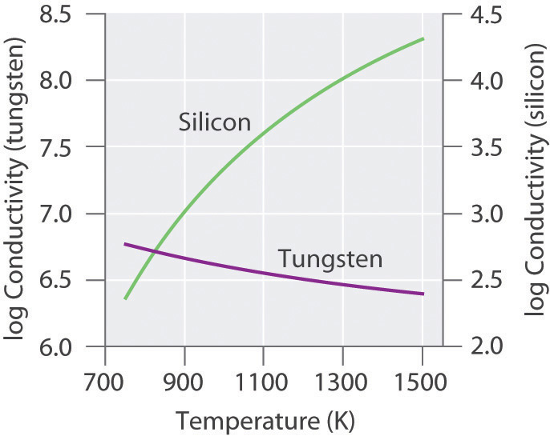
As the temperature of the solid increases, the metal atoms in the lattice acquire more and more kinetic energy. Because their positions are fixed in the lattice, however, the increased kinetic energy increases only the extent to which they vibrate about their fixed positions. At higher temperatures, therefore, the metal nuclei collide with the mobile electrons more frequently and with greater energy, thus decreasing the conductivity. This effect is, however, substantially smaller than the increase in conductivity with temperature exhibited by semiconductors.
For example, the conductivity of a tungsten wire decreases by a factor of only about two over the temperature range 750–1500 K, whereas the conductivity of silicon increases approximately 100-fold over the same temperature range.
The Temperature Dependence of the Electrical Conductivity of a Metal versus a Semiconductor. The conductivity of the metal (tungsten) decreases relatively slowly with increasing temperature, whereas the conductivity of the semiconductor (silicon) increases much more rapidly.

Slide 18
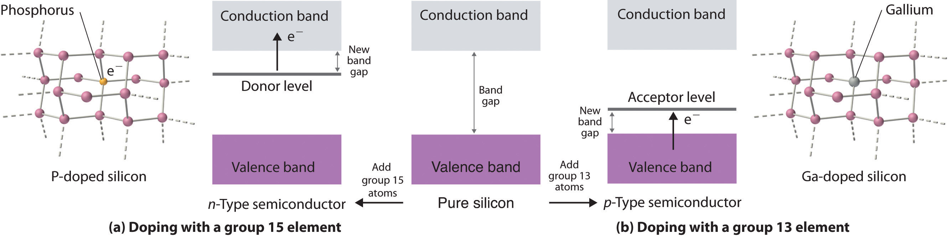
n- and p-Type Semiconductors
Doping is a process used to tune the electrical properties of commercial semiconductors by deliberately introducing small amounts of impurities. If an impurity contains more valence electrons than the atoms of the host lattice (e.g., when small amounts of a group 15 atom are introduced into a crystal of a group 14 element), then the doped solid has more electrons available to conduct current than the pure host has. As shown in Figure
Structures and Band Diagrams of n-Type and p-Type Semiconductors. (a) Doping silicon with a group 15 element results in a new filled level between the valence and conduction bands of the host. (b) Doping silicon with a group 13 element results in a new empty level between the valence and conduction bands of the host. In both cases, the effective band gap is substantially decreased, and the electrical conductivity at a given temperature increases dramatically.

Slide 19
If the impurity atoms contain fewer valence electrons than the atoms of the host (e.g., when small amounts of a group 13 atom are introduced into a crystal of a group 14 element), then the doped solid has fewer electrons than the pure host. Perhaps unexpectedly, this also results in increased conductivity because the impurity atoms generate holes in the valence band. As shown in Figure in previous slide, adding an impurity such as gallium to a silicon crystal creates isolated electron-deficient sites in the host lattice. The electronic energy of these empty sites also lies between those of the filled valence band and the empty conduction band of the host but much closer to the filled valence band. It is therefore relatively easy to excite electrons from the valence band of the host to the isolated impurity atoms, thus forming holes in the valence band. This kind of substance is called a p-type semiconductor, with the p standing for positive charge carrier (i.e., a hole). Holes in what was a filled band are just as effective as electrons in an empty band at conducting electricity.

Slide 20
The electrical conductivity of a semiconductor is roughly proportional to the number of charge carriers, so doping is a precise way to adjust the conductivity of a semiconductor over a wide range. The entire semiconductor industry is built on methods for preparing samples of Si, Ge, or GaAs doped with precise amounts of desired impurities and assembling silicon chips and other complex devices with junctions between n- and p-type semiconductors in varying numbers and arrangements.
Because silicon does not stand up well to temperatures above approximately 100°C, scientists have been interested in developing semiconductors made from diamonds, a more thermally stable material. A new method has been developed based on vapor deposition, in which a gaseous mixture is heated to a high temperature to produce carbon that then condenses on a diamond kernel. This is the same method now used to create cultured diamonds, which are indistinguishable from natural diamonds. The diamonds are heated to more than 2000°C under high pressure to harden them even further. Doping the diamonds with boron has produced p-type semiconductors, whereas doping them with boron and deuterium achieves n-type behavior. Because of their thermal stability, diamond semiconductors have potential uses as microprocessors in high-voltage applications.

